Slide 1

IT 353 Web Development Technologies
Jianwei Lai
jlai12@ilstu.edu

Slide 2
Today’s Content
HTML form
HTML5 form elements
Assignment 1

Slide 3
Let’s create a form first

Slide 4
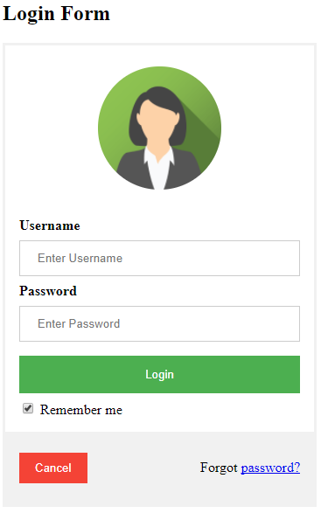
Heading 2
<form>
….
</form>
<!DOCTYPE html>
<html>
<head>
<title>Login Form</title>
</head>
<body>
<h2>Login Form</h2>
<form>
</form>
</body>
</html>
https://www.w3schools.com/howto/tryit.asp?filename=tryhow_css_login_form

Slide 5
<form>
<div>
<img src="img_avatar.png" alt="Avatar">
</div>
<div>
<label><b>Username</b></label>
<input type="text" placeholder="Enter Username" name="uname" required>
<label><b>Password</b></label>
<input type="password" placeholder="Enter Password" name="psw" required>
<button type="submit">Login</button>
<input type="checkbox" checked="checked"> Remember me
</div>
</form>
https://www.w3schools.com/howto/tryit.asp?filename=tryhow_css_login_form
Notes:
https://www.w3schools.com/howto/tryit.asp?filename=tryhow_css_login_form
? filename =
&userid=12355
Where to put the img? Relative path
Meaning of alt

Slide 6
What is alt for?
<img src="img_avatar.png" alt="Avatar">
The alt attribute provides alternative information for an image if a user for some reason cannot view it (because of slow connection, an error in the src attribute, or if the user uses a screen reader).

Slide 7
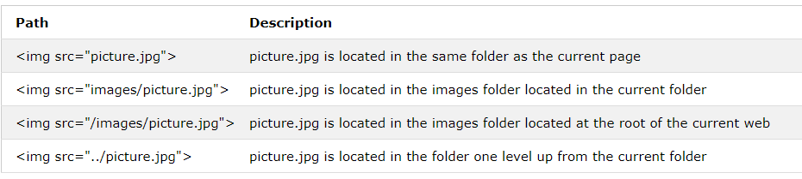
File path
Relative file path
Absolute File Paths
<img src="https://www.w3schools.com/images/picture.jpg" alt="Mountain">
Notes:
Try put the file in different places

Slide 8
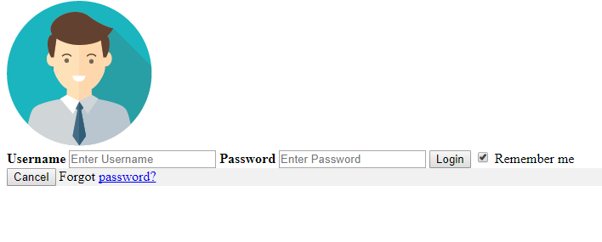
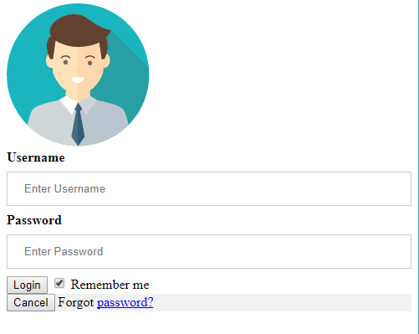
Add some style
<style>
form {
border: 3px solid #f1f1f1;
}
input[type=text], input[type=password] {
width: 100%;
padding: 12px 20px;
margin: 8px 0;
display: inline-block;
border: 1px solid #ccc;
box-sizing: border-box;
}
</style>
Notes:
, is important
RGB

Slide 9
Inline vs internal vs external css
<!DOCTYPE html> <html> <head> <style> body {background-color: powderblue;} h1 {color: blue;} p {color: red;} </style> </head> <body> <h1>This is a heading</h1> <p>This is a paragraph.</p> </body> </html>
<h1 style="color:blue;">A Blue Heading</h1>
<!DOCTYPE html> <html> <head> <link rel="stylesheet" href="styles.css"> </head> <body> <h1>This is a heading</h1> <p>This is a paragraph.</p> </body> </html>
Notes:
Space
No space
<p style="color:red;">
body{
background-color:powderblue;
}
h1{
color:blue;
}
p{
color:red;
}

Slide 10
HTML5: Input types
HTML5 has several new input types for forms.
> email
> url
> number
> range
> date pickers (date, month, week, time, datetime, datetime-local)‏
> search
> color
…

Slide 11
HTML5: Input - email
The email type is used for input fields that should contain an e-mail address.
The value of the email field is automatically validated when the form is submitted.
E-mail: <input type="email" name="user_email" />
Depending on browser support, the e-mail address can be automatically validated when submitted.
Some smartphones recognize the email type, and adds ".com" to the keyboard to match email input.
http://www.w3schools.com/html/tryit.asp?filename=tryhtml_input_email
Notes:
Why define type- input validation
Feedback principle

Slide 12

HTML5: Input - url
The url type is used for input fields that should contain a URL address.
The value of the url field is automatically validated when the form is submitted.
Homepage: <input type="url" name="user_url" />
http://www.w3schools.com/html/tryit.asp?filename=tryhtml_input_url
Tip: Safari on the iPhone recognizes the url input type, and changes the on-screen keyboard to match it (adds .com option).
Notes:
Constraint principle

Slide 13
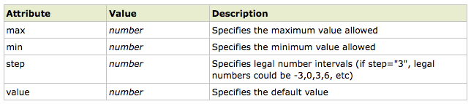
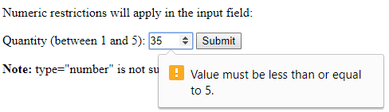
HTML5: Input - number
The number type is used for input fields that should contain a numeric value.
Set restrictions on what numbers are accepted:
Points: <input type="number" name="points" min="1" max="10" />
http://www.w3schools.com/html/tryit.asp?filename=tryhtml_input_number
Notes:
id vs name

Slide 14
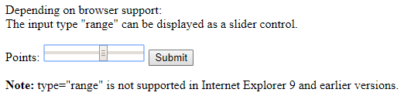
HTML5: Input - range
The range type is used for input fields that should contain a value from a range of numbers.
The range type is displayed as a slider bar.
You can also set restrictions on what numbers are accepted:
<input type="range" name="points" min="1" max="10" />
http://www.w3schools.com/html/tryit.asp?filename=tryhtml_input_range

Slide 15
HTML5: Input – date pickers
HTML5 has several new input types for selecting date and time:
> date - Selects date, month and year
> month - Selects month and year
> week - Selects week and year
> time - Selects time (hour and minute)‏
> datetime - Selects time, date, month and year
> datetime-local - Selects time, date, month and year (local time)‏
<label for="birthday">Birthday:</label>
<input type="date">

Slide 16
HTML5: Input - search
The search type is used for search fields like a site search or Google search.

Slide 17
HTML5: Input – color picker
The color type is used for input fields that should contain a color.
This input type will allow you to select a color from a color picker:
Color: <input type="color" name="user_color" />

Slide 18
HTML5: Reference
For a decent list of references:
https://www.w3schools.com/html/html5_intro.asp
Notes:
.asp
.php
Friendly url
https://serpstat.com/blog/how-to-configure-friendly-urls-for-page-addresses/
www.backpack.com/index.php?cPath=63

Slide 19
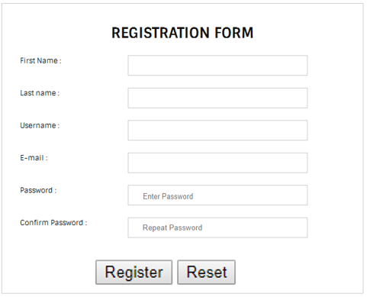
Some practice
Create a registration form
Make sure all fields are required
Use correct input types for the fields, for example, type = “reset” for the Reset button
Use placeholders, such as “Enter Password”
Add some style to the form

Slide 20
Assignment 1
Finish the HTML quiz https://www.w3schools.com/html/html_quiz.asp
Take a screenshot of your score
You can take as many time as you want
Submit your screenshot to Reggienent by 9/1 11:55pm

Slide 21
Before next class
Read css tutorial https://www.w3schools.com/css/default.asp

